Slide 1
Phone Book Management
Ali Hassan Programmer
Semester project

Slide 2
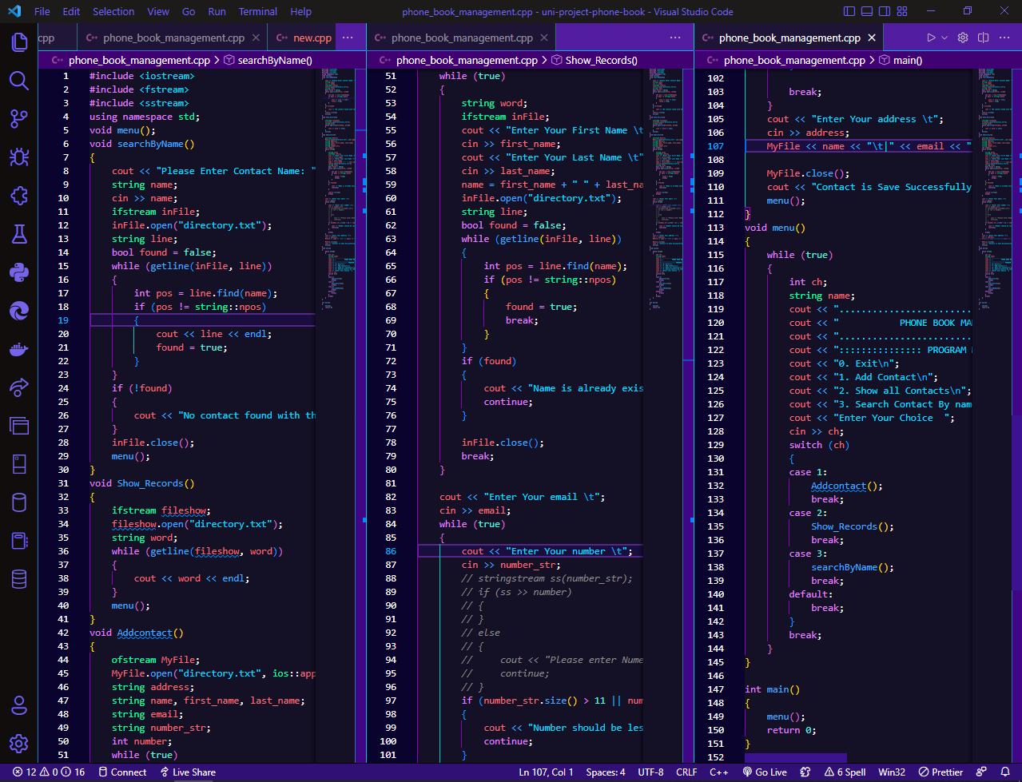
This is full code of phone book project

Slide 3
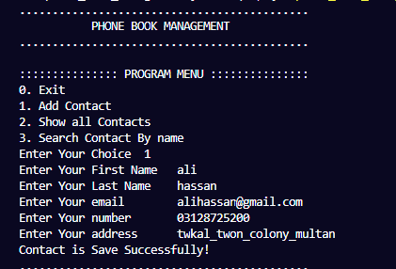
First Name Last Name E-mail Number Address
Front-end menu
Chose 1st option in which add contact

Slide 4
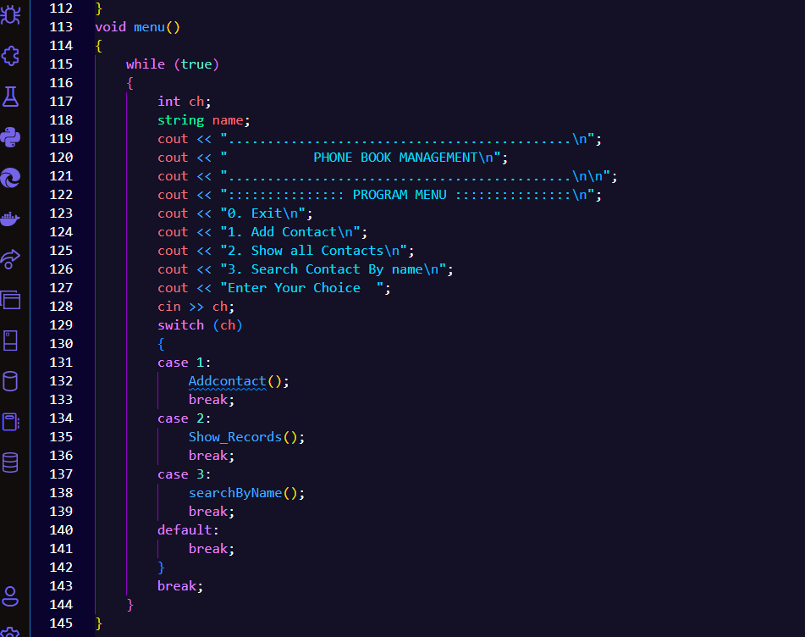
Back-end code of Manu bar

Slide 5
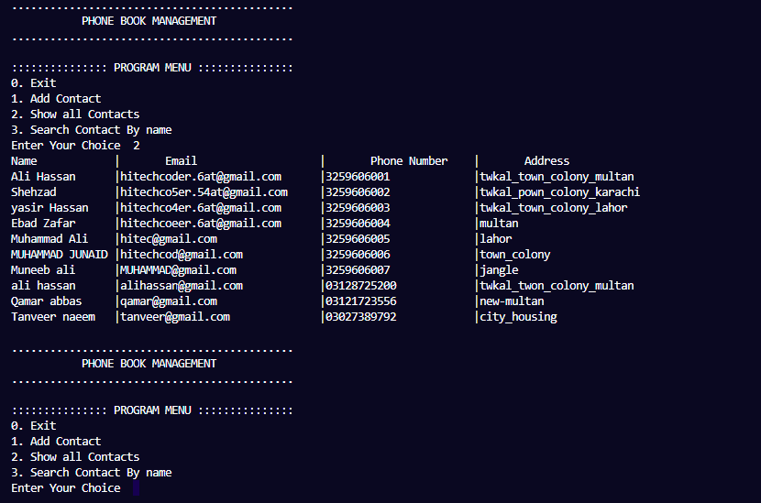
Show all Contacts
Show all data and loop is again work in the menu form
Chose 2nd option in which Show Contacts

Slide 6
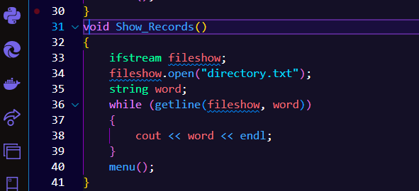
Back-end code

Slide 7
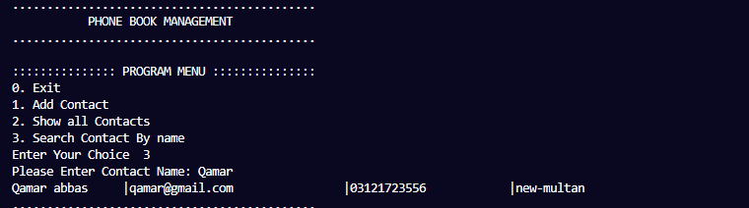
Search contact by name
Chose 3rd option in which Show Contacts

Slide 8
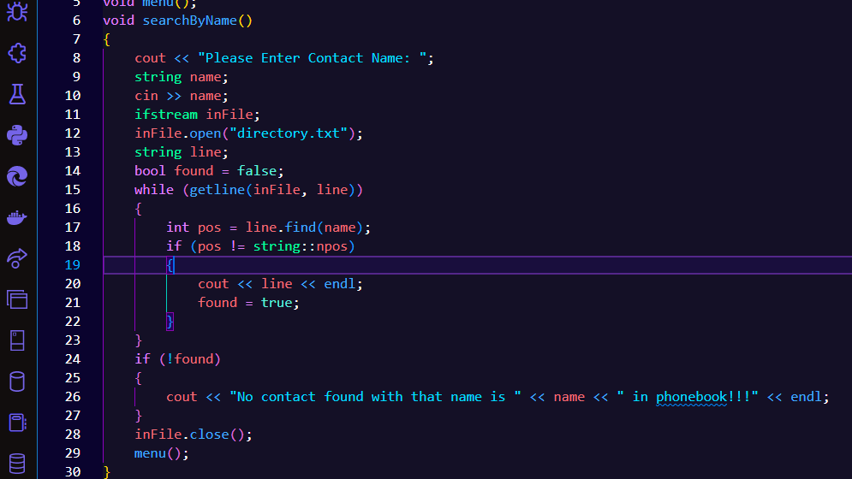
Back-end code of Searching Name

Slide 9
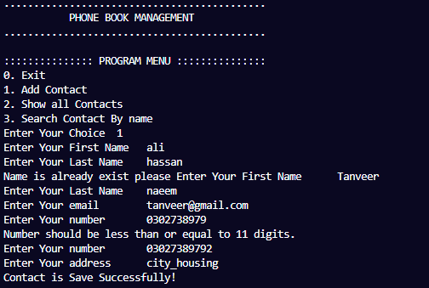
Loop-Holes solutions

